Slide 1
HCT NLP Week 5
基于Transformer特征提取器的改进

Slide 2
Outline
Transformer与RNNs的区别
Transformer模型改进
图神经网络在摘要任务中的应用
相关代码实践

Slide 3
Outline
Transformer与RNNs的区别
Transformer模型改进
图神经网络在摘要任务中的应用
相关代码实践

Slide 4
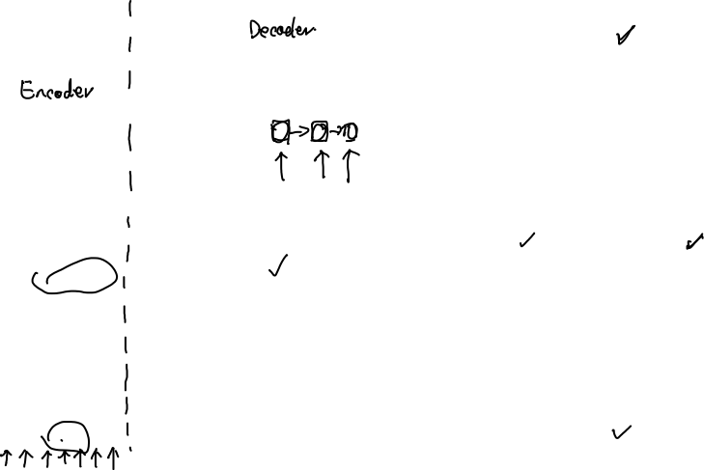
Attention Is All You Need

Slide 5
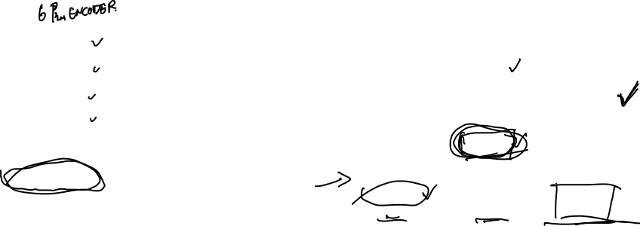

Slide 6
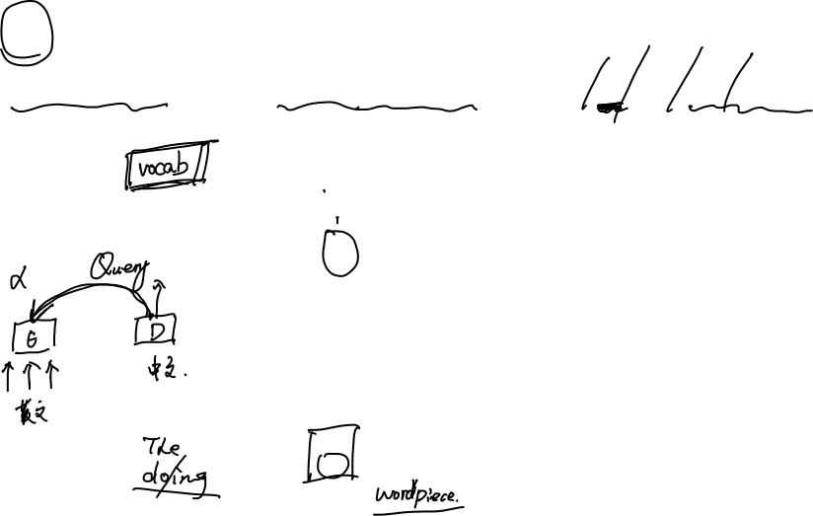
自注意力
The animal did not cross the street because it was too tired.

Slide 7
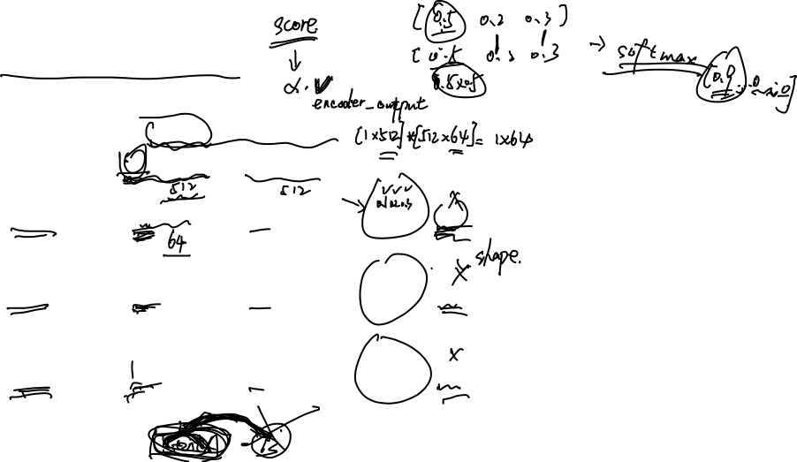
self-attention

Slide 8
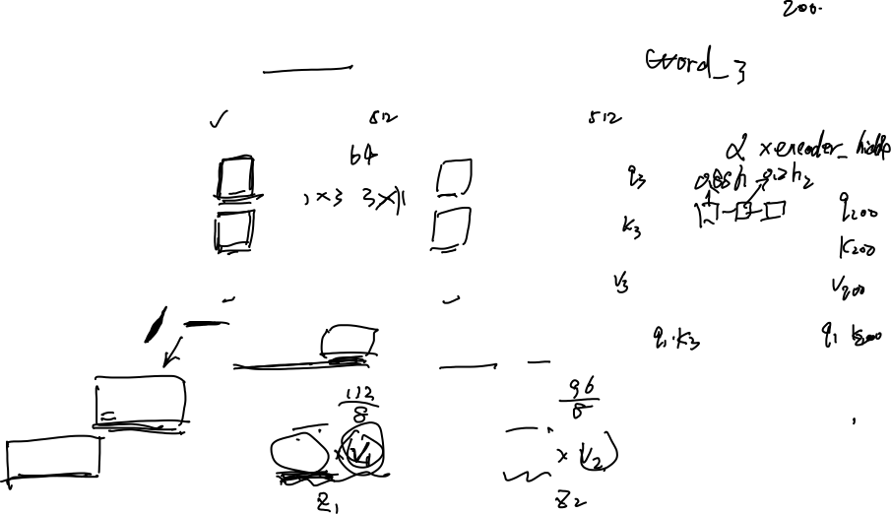

Slide 9
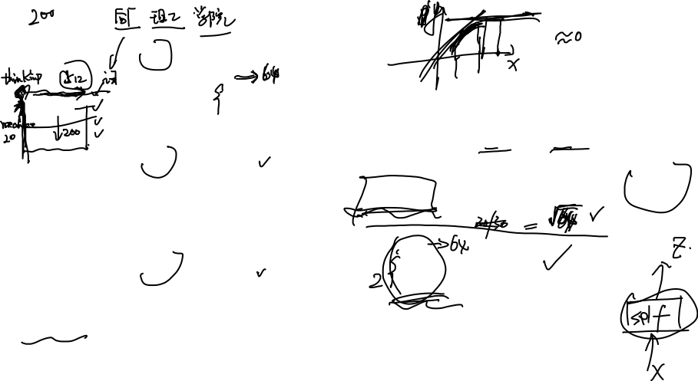

Slide 10
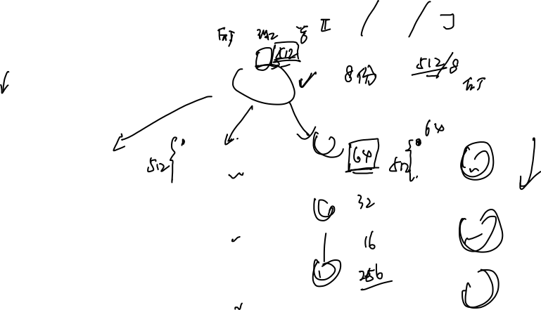
Multi-headed

Slide 11
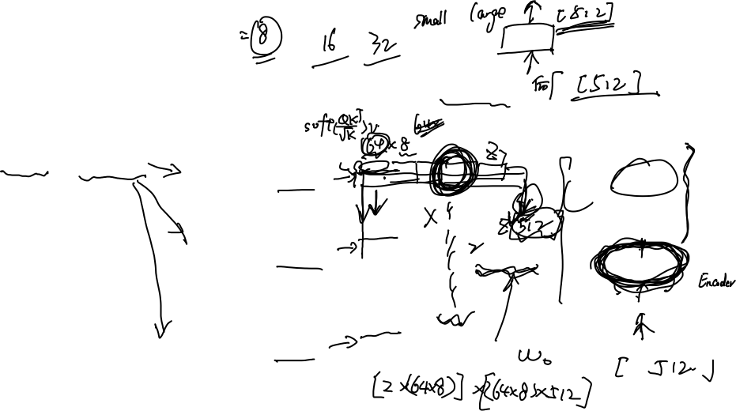
Multi-headed

Slide 12
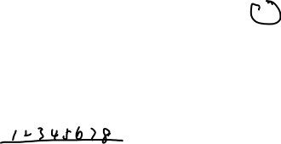

Slide 13
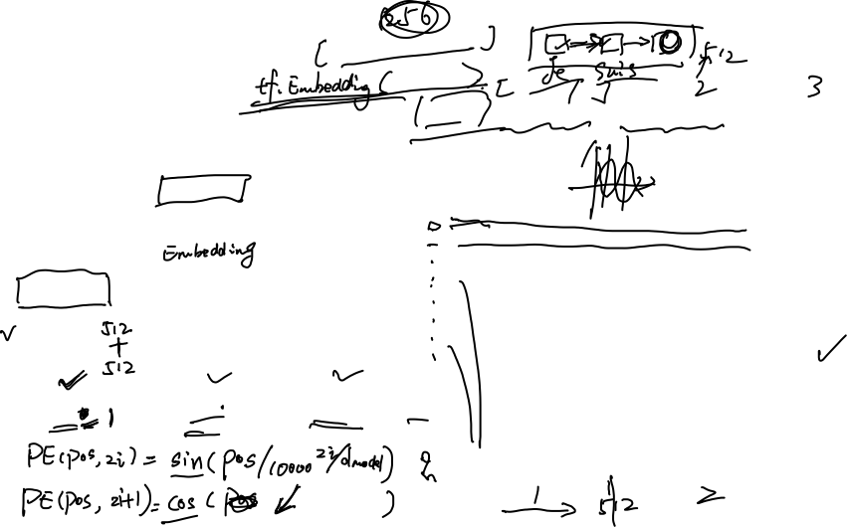
Input Embedding

Slide 14
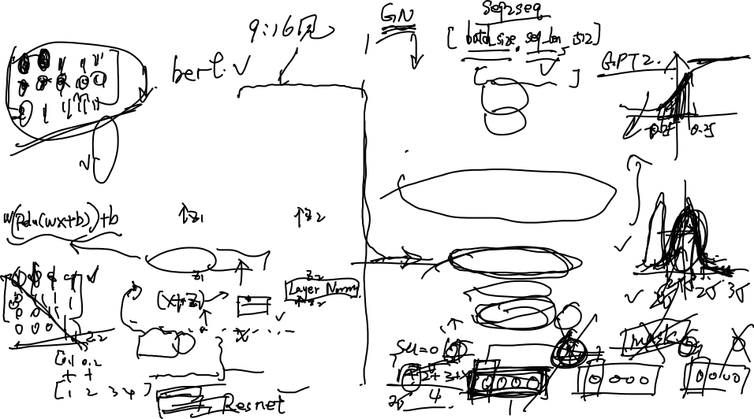
Transformer

Slide 15
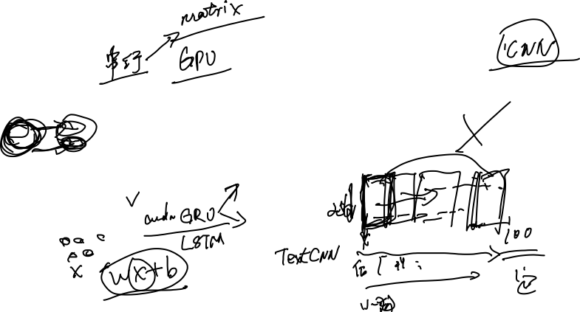
RNN、CNN、Transformer对比

Slide 16
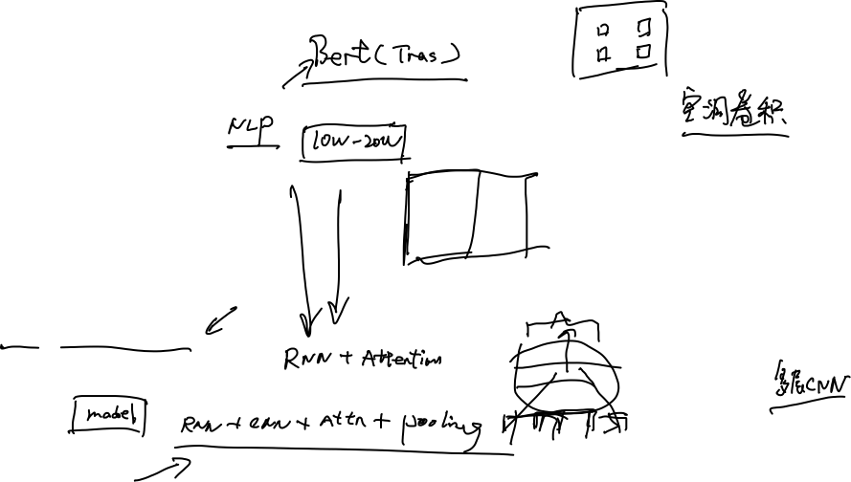
CNN的进化

Slide 17
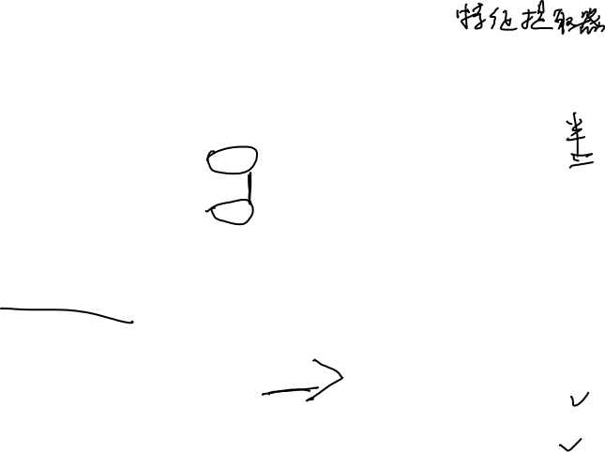
RNN、CNN、Transformer对比
语义特征提取能力、任务综合特征抽取能力
长距离特征捕获能力
Why Self-Attention? A Targeted Evaluation of Neural Machine Translation Architectures

Slide 18
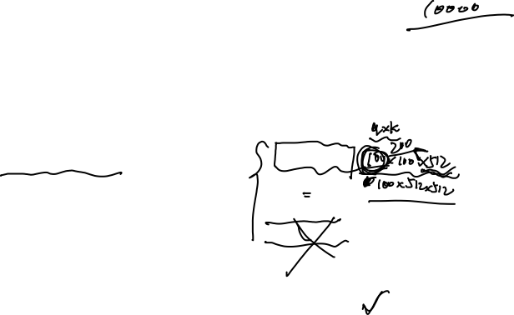
并行计算能力及运行效率
Tensor2Tensor for Neural Machine Translation

Slide 19
Outline
Transformer与RNNs的区别
Transformer模型改进
图神经网络在摘要任务中的应用
相关代码实践

Slide 20
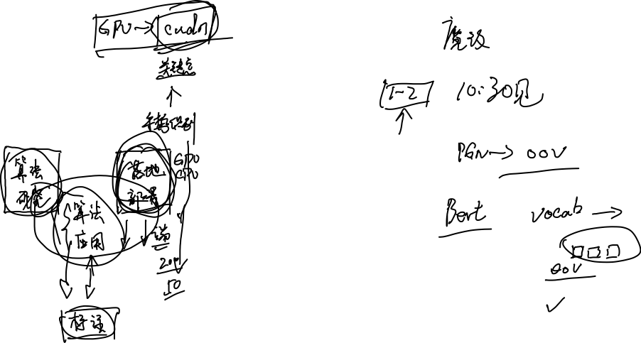
PGN-Transformer
Transformers and Pointer-Generator Networks for Abstractive Summarization

Slide 21
Outline
Transformer与RNNs的区别
Transformer模型改进
图神经网络在摘要任务中的应用
相关代码实践

Slide 22
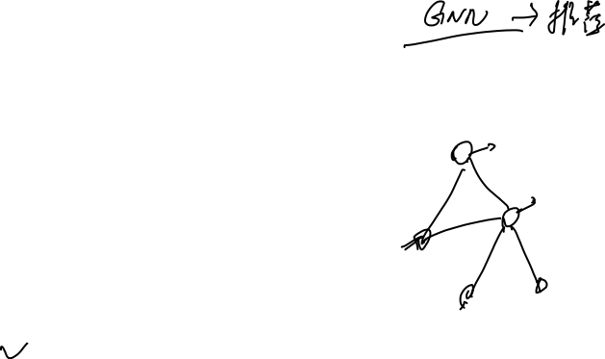
Transformer是不是一种图网络

Slide 23
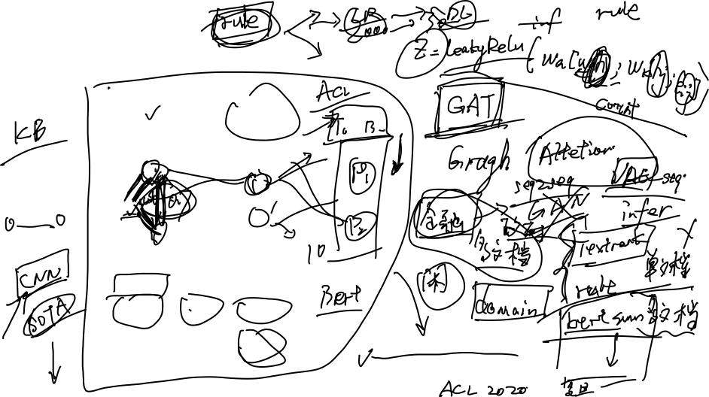
Graph for summarization
Heterogeneous Graph Neural Networks for Extractive Document Summarization

Slide 24
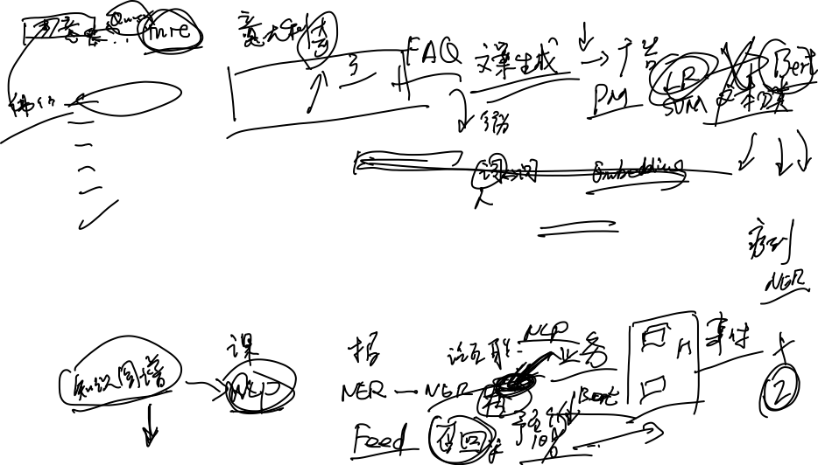
最近一些研究
Modeling Global and Local Node Contexts for Text Generation from Knowledge Graphs
Text Generation from Knowledge Graphs with Graph Transformers
Structured Neural Summarization
Discourse-Aware Neural Extractive Model for Text Summarization
Graph-based Neural Multi-Document Summarization

Slide 25
Outline
Transformer与RNNs的区别
Transformer模型改进
图神经网络在摘要任务中的应用
相关代码实践

Slide 26
作业

Slide 27
Bye ！

